Slide 1
BRIDGE DESIGN
Chapter 3:
ANALYTICAL PROCEDURE
Dr Shahiron Shahidan
shahiron@uthm.edu.my
drshahironshahidan.weebly.com

Slide 2
Outline
Fundamental Concepts
Influence line Analysis
Collapse Analysis
Grillage Analysis

Slide 3
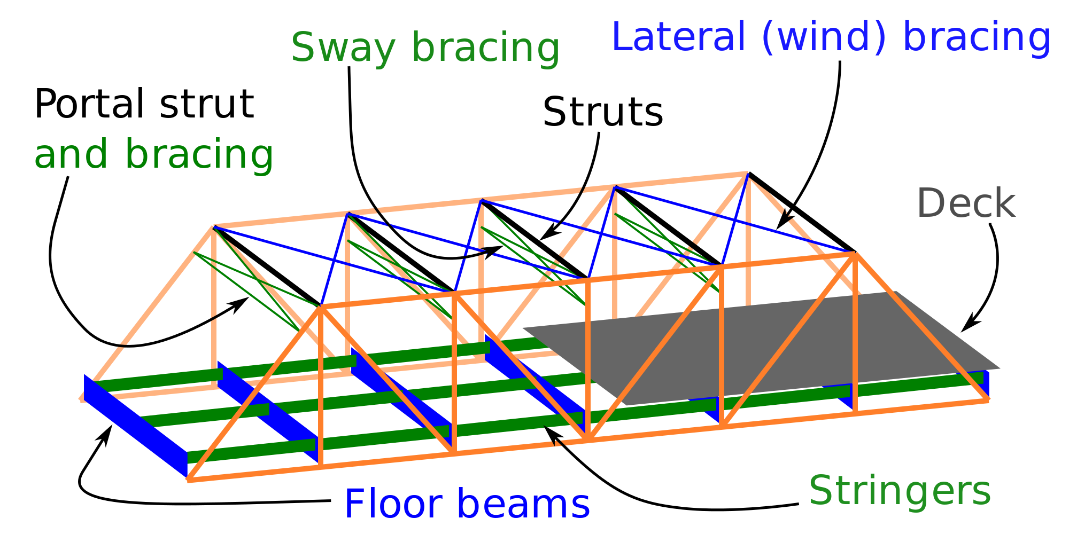
3.1 Fundamental Concepts
Structural analysis is essential in bridge analysis. It is part of simplified mathematical modelling of the response of a structure to the applied loading.
Model are based on the idealizations of the structural behaviour of the material, depending upon the simplifying assumption in modelling.

Slide 4
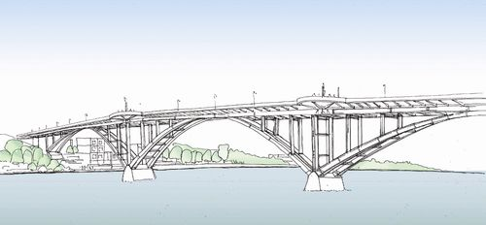
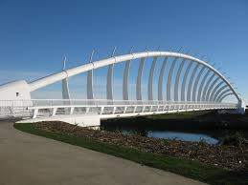
Example of idealizations introduced in the modelling process:
The physical dimension of the structural components are idealised. Eq: skeletal structures are represented by a series of line element and joint are assumed to be negligible size.
Material behaviour is simplified. Eq: The stress- strain characteristic of concrete/ steel is assumed to be linearly elastic and then perfectly plastic.
The implications of actions which are included in the analytical process itself are frequently ignored. Eq: The possible effects of change of geometry causing local instability are rarely, if ever accounted for in the analysis

Slide 5
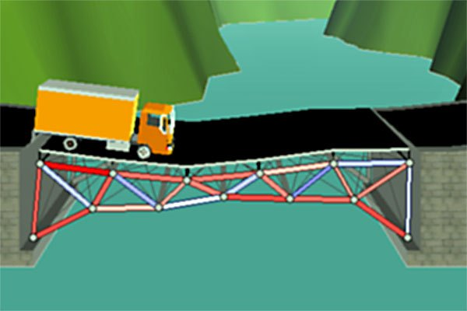
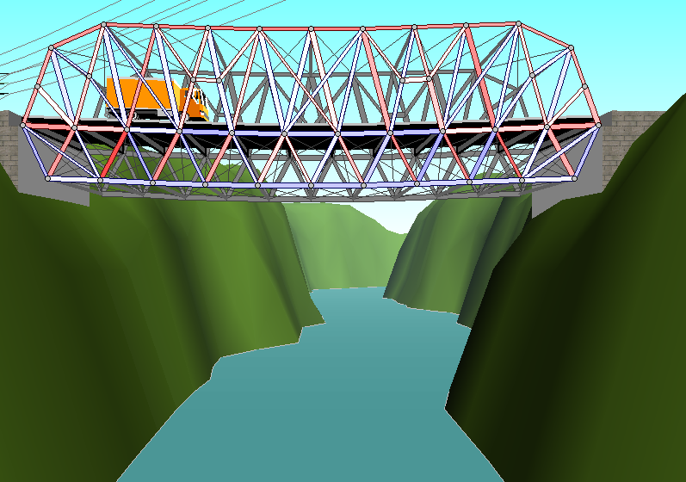
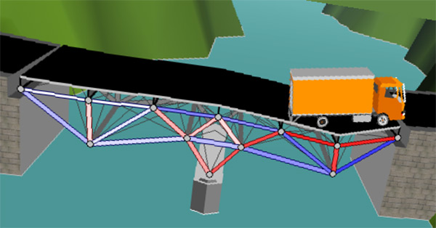
Stress distribution on the bridges

Slide 6
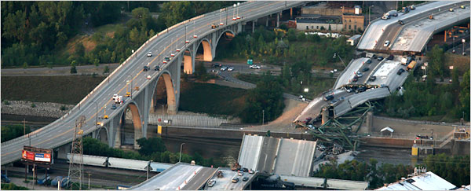
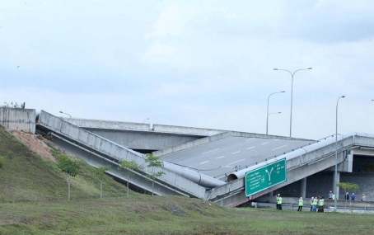
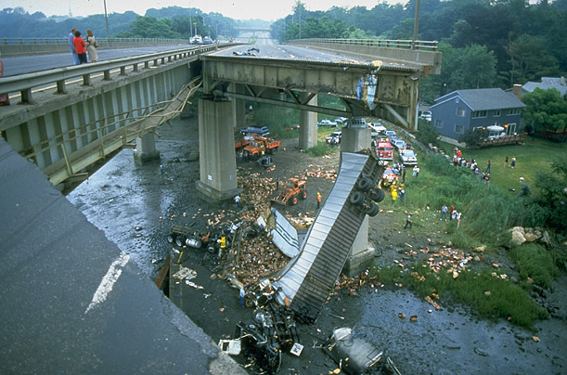
Bridges Failure
The entire span of the Interstate 35W bridge collapsed in Minneapolis, 2007
Putrajaya, Malaysia, 2013
Mianus Bridge, Greenwich, June 28, 1983

Slide 7
3.2 INFLUENCE LINES

Slide 8
3.2.1 Introduction
In this chapter will be discussed:
the moving load from one point to another point such as the live loads for bridge
because of the moving vehicles
represents the variation of the reaction, shear, moment or deflection at a specific point in a member as a concentrated force moves over the member.

Slide 9
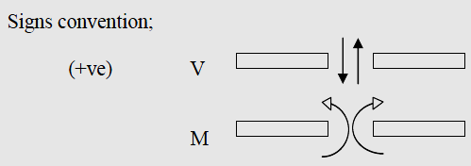
3.2.2 INFLUENCE LINES FOR BEAMS
Procedures in constructing the influence lines:
allow a one unit load (either 1kN, 1N, 1kip or 1 ton) to move over the beam from left to right.
find the values of shear force or bending moment at the point under consideration as the unit load moves over the beam from left to right.
plot the values of the shear force or bending moment over the length of the beam computed for the point under consideration

Slide 10
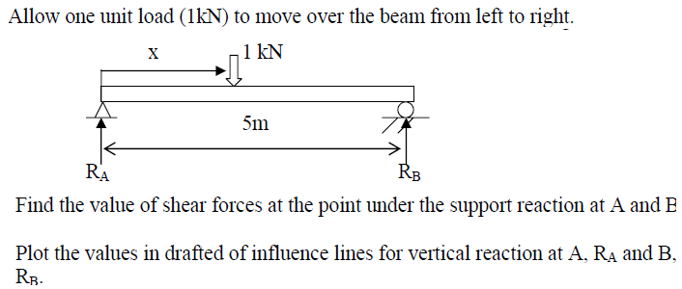
EX:1 (Variations of reaction)
Solution:

Slide 11
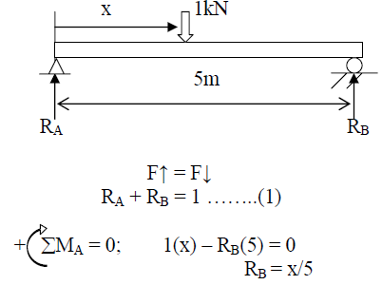
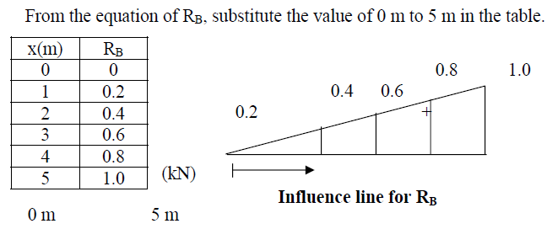

Slide 12
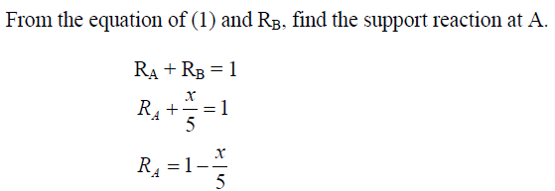
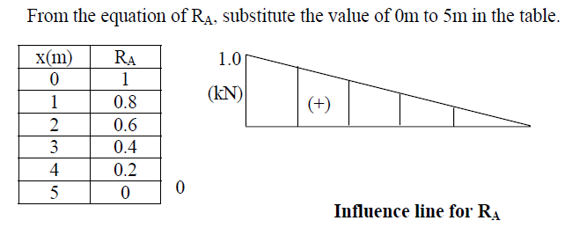

Slide 13
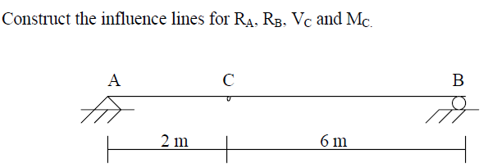
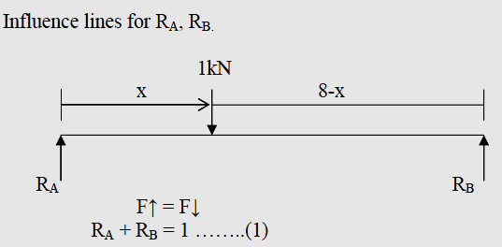
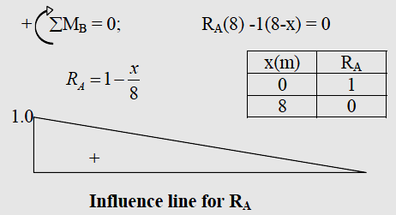
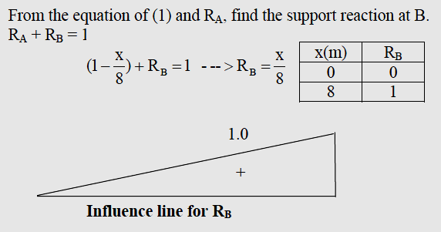
EX:2 (Variations of reaction)
Solution: (a)

Slide 14
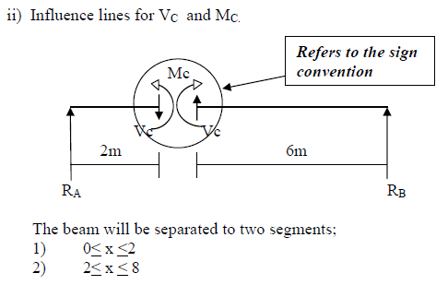
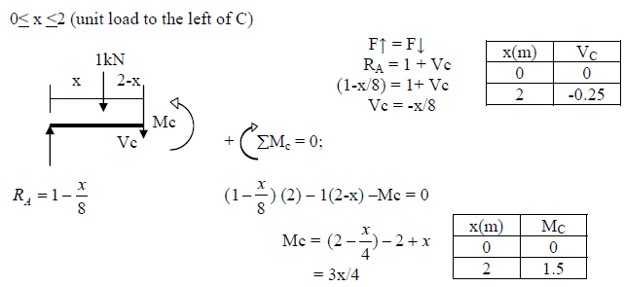
Solution: (b)

Slide 15
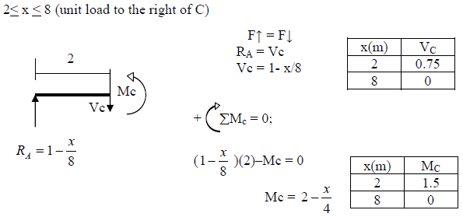
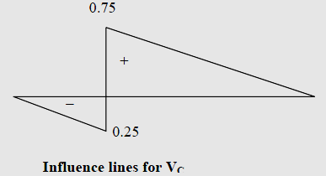
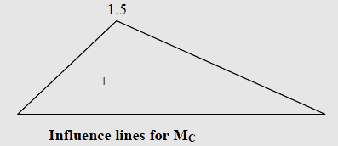

Slide 16
3.2.3 -QUALITATIVE INFLUENCED LINES – -MULLER-BRESLAU’S PRINCIPLE-
The principle gives only a procedure to determine of the influence line of a parameter for a determinate /indeterminate structure
But using the basic understanding of the influence lines, the magnitudes of the influence lines also can be computed
In order to draw the shape of the influence lines properly, the capacity of the beam to resist the parameter investigated (reaction, bending moment, shear force, etc.), at that point, must be removed
The principle states : The influence line for a function (e.g. reaction, shear, moment) at a point, is to the same scale as the deflected shape of the beam when the beam is acted upon by that function.
The capacity of the beam to resist that parameter, at that point, must be removed.
Then allow the beam to deflect under that parameter
Positive directions of the forces are the same as before

Slide 17
3.2.4 -QUALITATIVE INFLUENCE LINES : PROBLEMS
3.2.4.1 Influence Line for a Determinate Beam by Muller-
Breslau’s Method (Simply Supported Beam-Pin Join)
Remove the ability to resist movement in the vertical direction at A by using a guided roller
Deflection, y
Influence line for Reaction at A

Slide 18
3.2.4.2 Influence Lines for a Determinate Beam by Muller- Breslau’s Method (Cantilever beam-fixed support)
Use a double roller to transmit moments and axial load at the fixed support. Vertical reaction will not transmit horizontal reaction.
Influence line for Reaction at A

Slide 19
3.2.4.3 Influence Lines for a Determinate Beam by Muller- Breslau’s Method (Indeterminate Beam-Shear)
At roller support, consider the vertical reaction at this point.
Influence Line for Reaction at indeterminate beam

Slide 20
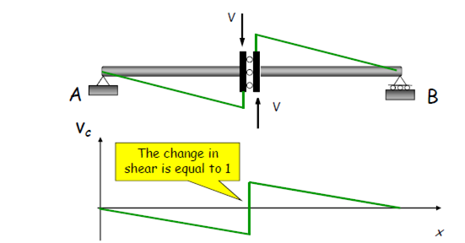
3.2.4.4 Influence Lines for a Determinate Beam by Muller- Breslau’s Method (Shear at the mid-span)
Remove the ability to resist shear at point C with roller connection. Applying a positive shear force to the beam at C and allows the deflection.
Influence Line for Shear at C

Slide 21
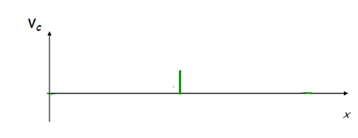
3.2.4.5 Influence Lines for a Determinate Beam by Muller- Breslau’s Method (Shear at the cantilever beam)
A roller guide must be placed at C, the positive shear is applied. The left segment of the beam does not deflect due to fixed support.
Influence Line for Shear at C

Slide 22
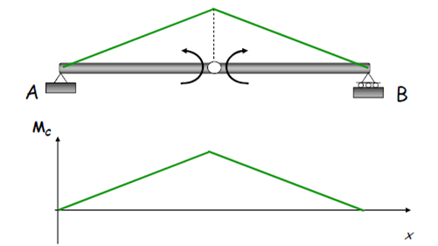
3.2.4.6 Influence Lines for a Determinate Beam by Muller- Breslau’s Method (Moment at the mid-span)
Remove the ability to resist moment at C by using hinge. Moments will occur at both segments.
Influence Line for Bending Moment at C

Slide 23
Ex :Draw the influence lines for the vertical reaction at D and the shear at E.
10m
10m
15m
15m
If the change in shear at point E is equal to 1, find the shear value at points E and C.

Slide 24
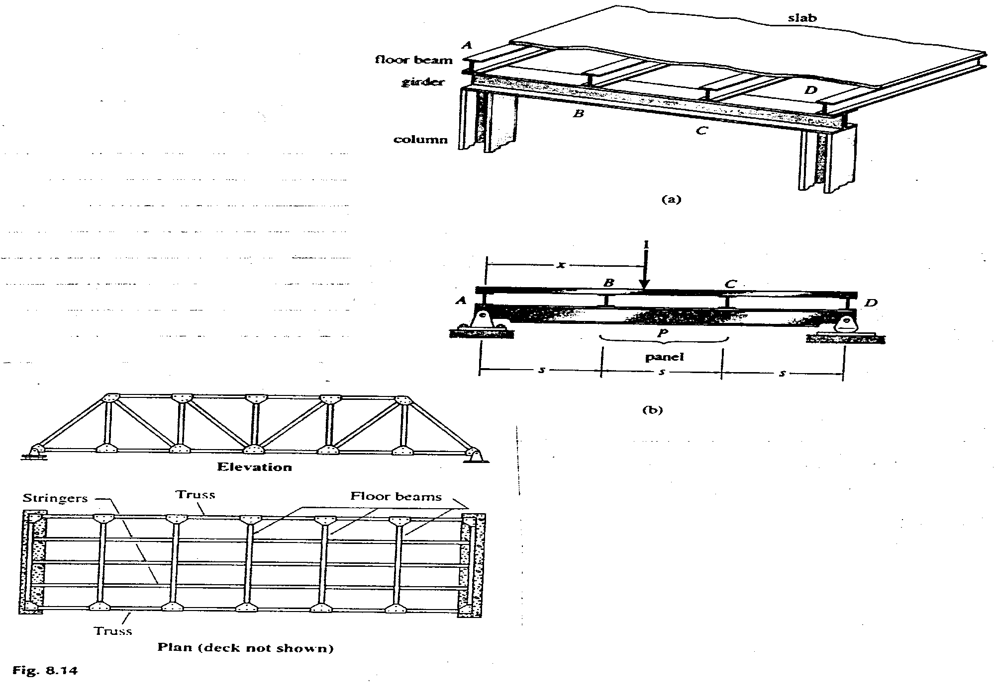
3.5 INFLUENCE LINE FOR FLOOR GIRDERS Floor systems are constructed as shown in figure below,

Slide 25
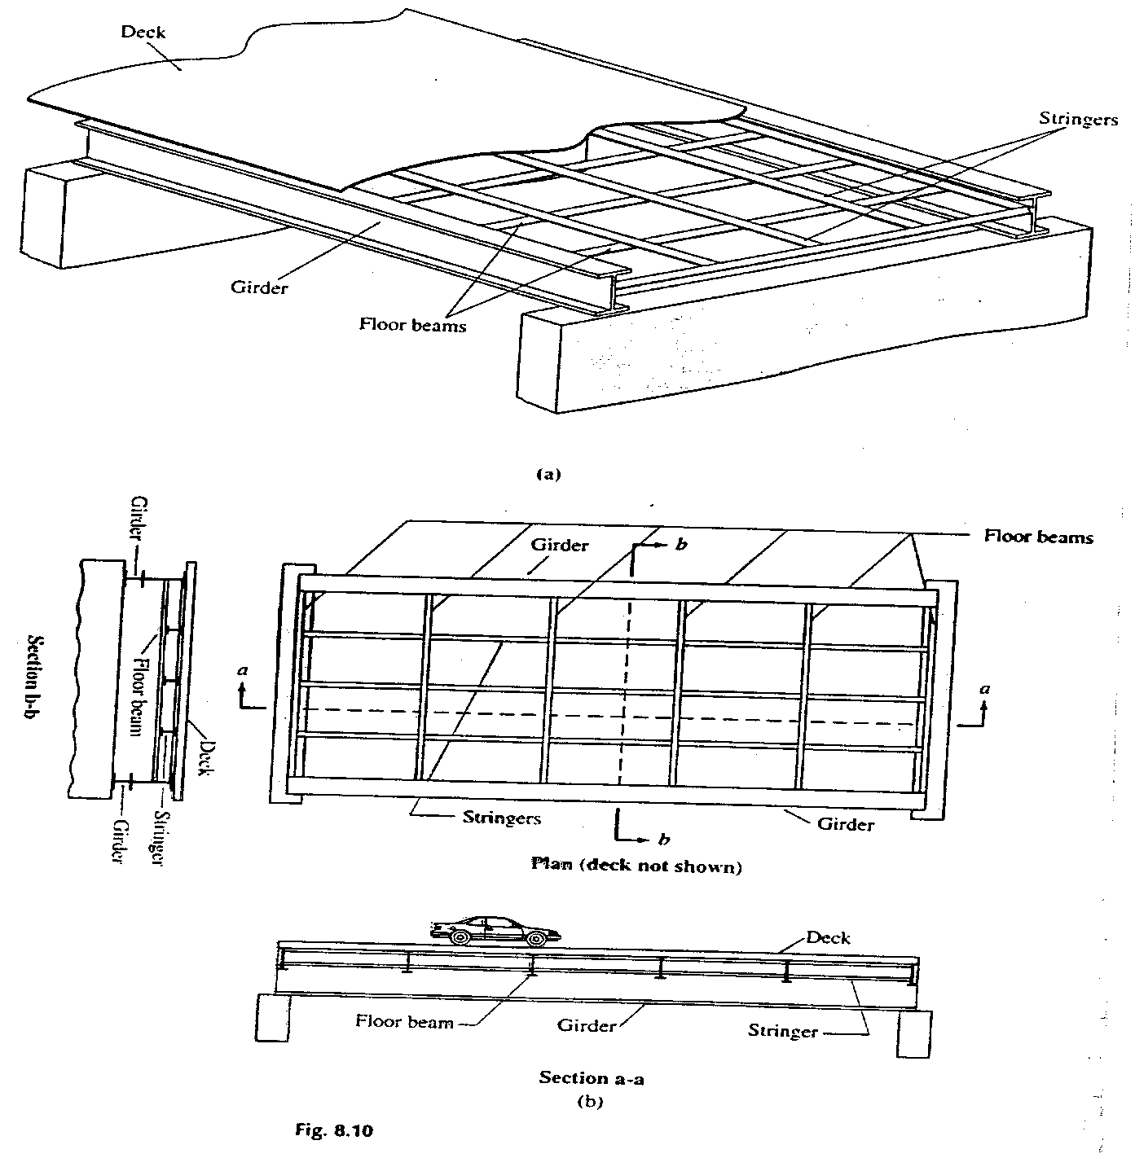
3.5 INFLUENCE LINES FOR FLOOR GIRDERS (Cont’d)

Slide 26
3.5 INFLUENCE LINES FOR FLOOR GIRDERS (Cont’d)
3.5.1 Force Equilibrium Method:
Draw the Influence Lines for: (a) Shear in panel CD of the girder; and (b) the moment at E.
x
A´
B´
C´
D´
E´
F´
A
B
C
D
E
F
5 spaces @ 10´ each = 50 ft

Slide 27
5.5.2 Place load over region A´B´ (0 < x < 10 ft)
Find the shear over panel CD
V_{CD}= - x/50
At x=0, V_{CD} = 0
At x=10, V_{CD} = -0.2
Find moment at E = +(x/50)(10)=+x/5
At x=0, M_{E}=0
At x=10, M_{E}=+2.0
C
D
F
Shear is -ve
R_{F}=x/50
F
E
+ve moment
R_{F}=x/50

Slide 28
Continuation of the Problem
x
-ve
0.2
I. L. for V_{CD}
2.0
+ve
I. L. for M_{E}

Slide 29
Problem Continued - 5.5.3 Place load over region B´C´ (10 ft < x < 20ft)
V_{CD} = -x/50 kip
At x = 10 ft
V_{CD} = -0.2
At x = 20 ft
V_{CD} = -0.4
M_{E} = +(x/50)(10)
= +x/5 kip.ft
At x = 10 ft, M_{E} = +2.0 kip.ft
At x = 20 ft, M_{E} = +4.0 kip.ft
C
F
D
Shear is -ve
R_{F} = x/50
D
F
E
Moment is +ve
R_{F} = x/50

Slide 30
x
B´
C´
-ve
0.2
0.4
I. L. for V_{CD}
+ve
4.0
2.0
I. L. for M_{E}

Slide 31
5.5.4 Place load over region C´D´ (20 ft < x < 30 ft)
When the load is at C’ (x = 20 ft)
C
D
Shear is -ve
R_{F}=20/50
=0.4
V_{CD} = -0.4 kip
When the load is at D´ (x = 30 ft)
A
B
C
D
R_{A}= (50 - x)/50
Shear is +ve
V_{CD}= + 20/50
= + 0.4 kip

Slide 32
M_{E} = + (x/50)(10) = + x/5
Load P
x
E
+ve moment
R_{F}= x/50
D´
A´
B´
C´
A
B
C
+ve
0.2
-ve
0.4
D
I. L. for V_{CD}
+ve
2.0
4.0
6.0
I. L. for M_{E}

Slide 33
5.5.5 Place load over region D´E´ (30 ft < x < 40 ft)
V_{CD}= + (1-x/50) kip
A
E
B
C
D
R_{A}= (1-x/50)
Shear is +ve
M_{E}= +(x/50)(10)
= + x/5 kip.ft
E
Moment is +ve
R_{F}= x/50
At x = 30 ft, M_{E} = +6.0
At x = 40 ft, M_{E} = +8.0

Slide 34
Problem continued
x
A´
B´
C´
D´
E´
0.4
+ve
0.2
I. L. for V_{CD}
8.0
+ve
6.0
2.0
4.0
I. L. for M_{E}

Slide 35
5.5.6 Place load over region E´F´ (40 ft < x < 50 ft)
V_{CD} = + 1-x/50 At x = 40 ft, V_{CD}= + 0.2
At x = 50 ft, V_{CD} = 0.0
x
1.0
A
B
E
C
D
R_{A}= 1-x/50
Shear is +ve
M_{E}= + (1-x/50)(40) = (50-x)*40/50 = +(4/5)(50-x)
x
A
B
C
D
E
F
Moment is +ve
R_{A}=1-x/50
At x = 40 ft, M_{E}= + 8.0 kip.ft
At x = 50 ft, M_{E} = 0.0

Slide 36
x
1.0
A´
B´
C´
D´
E´
F´
0.4
+ve
0.2
-ve
0.4
0.2
I. L. for V_{CD}
2.0
6.0
+ve
8.0
4.0
I. L. for M_{E}

Slide 37
5.6 INFLUENCE LINES FOR TRUSSES
Draw the influence lines for: (a) Force in Member GF; and
(b) Force in member FC of the truss shown below in Figure below
G
F
E
20 ft
10(3)^{1/3}
60⁰
A
D
B
C
20 ft
20 ft
20 ft

Slide 38
Problem 3.7 continued -
5.6.1 Place unit load over AB
(i) To compute GF, cut section (1) - (1)
(1)
G
F
E
1-x/20
1
x/20
x
A
60⁰
B
C
D
R_{A}= 1- x/60
(1)
R_{D}=x/60
Taking moment about B to its right,
(R_{D})(40) - (F_{GF})(10√3) = 0
F_{GF} = (x/60)(40)(1/ 10√3) = x/(15 √3) (-ve)
At x = 0,
F_{GF} = 0
At x = 20 ft
F_{GF} = - 0.77

Slide 39
PROBLEM 5.6 CONTINUED -
(ii) To compute F_{FC}, cut section (2) - (2)
(2)
G
F
E
x
1
x/20
1-x/20
30⁰
reactions at nodes
60⁰
A
B
C
D
R_{A} =1-x/60
(2)
R_{D}=x/60
Resolving vertically over the right hand section
F_{FC} cos30⁰ - R_{D} = 0
F_{FC} = R_{D}/cos30 = (x/60)(2/√3) = x/(30 √3) (-ve)

Slide 40
At x = 0, F_{FC} = 0.0
At x = 20 ft, F_{FC} = -0.385
20 ft
I. L. for F_{GF}
-ve
0.77
-ve
I. L. for F_{FC}
0.385

Slide 41
PROBLEM 5.6 Continued -
5.6.2 Place unit load over BC (20 ft < x <40 ft)
[Section (1) - (1) is valid for 20 < x < 40 ft]
(i) To compute F_{GF} use section (1) -(1)
(1)
G
F
E
(40-x)/20
x
1
(x-20)/20
reactions at nodes
A
D
20 ft
B
C
(1)
R_{A}=1-x/60
(x-20)
(40-x)
R_{D}=x/60
Taking moment about B, to its left,
(R_{A})(20) - (F_{GF})(10√3) = 0
F_{GF} = (20R_{A})/(10√3) = (1-x/60)(2 /√3)
At x = 20 ft, F_{FG} = 0.77 (-ve)
At x = 40 ft, F_{FG} = 0.385 (-ve)

Slide 42
PROBLEM 5.6 Continued -
(ii) To compute F_{FC}, use section (2) - (2)
Section (2) - (2) is valid for 20 < x < 40 ft
G
F
(2)
E
(40-x)/20
(x-20)/20
1
F_{FC}
x
30⁰
60⁰
A
B
C
D
R_{A} =1-x/60
(2)
R_{D}=x/60
Resolving force vertically, over the right hand section,
F_{FC} cos30 - (x/60) +(x-20)/20 = 0
F_{FC} cos30 = x/60 - x/20 +1= (1-2x)/60 (-ve)
F_{FC} = ((60 - 2x)/60)(2/√3) -ve

Slide 43
At x = 20 ft, F_{FC} = (20/60)(2/ √3) = 0.385 (-ve)
At x = 40 ft, F_{FC} = ((60-80)/60)(2/ √3) = 0.385 (+ve)
-ve
0.77
0.385
I. L. for F_{GF}
0.385
-ve
I. L. for F_{FC}

Slide 44
PROBLEM 5.6 Continued -
5.6.3 Place unit load over CD (40 ft < x <60 ft)
(i) To compute F_{GF}, use section (1) - (1)
(1)
G
F
E
(x-40)
1
(60-x)
x
(60-x)/20
(x-40)/20
A
D
20 ft
B
C
(1)
R_{A}=1-x/60
reactions at nodes
R_{D}=x/60
Take moment about B, to its left,
(F_{FG})(10√3) - (R_{A})(20) = 0
F_{FG} = (1-x/60)(20/10√3) = (1-x/60)(2/√3) -ve
At x = 40 ft, F_{FG} = 0.385 kip (-ve)
At x = 60 ft, F_{FG} = 0.0

Slide 45
PROBLEM 5.6 Continued -
(ii) To compute F_{FG}, use section (2) - (2)
reactions at nodes
G
F
E
(60-x)/20
(x-40)/20
F_{FC}
1
x
30⁰
60⁰
A
B
C
x-40
60-x
D
R_{A} =1-x/60
(2)
R_{D}=x/60
Resolving forces vertically, to the left of C,
(R_{A}) - F_{FC} cos 30 = 0
F_{FC} = R_{A}/cos 30 = (1-x/10) (2/√3) +ve

Slide 46
At x = 40 ft, F_{FC} = 0.385 (+ve)
At x = 60 ft, F_{FC} = 0.0
-ve
I. L. for F_{GF}
0.385
0.770
+ve
-ve
0.385
I. L. for F_{FC}

Slide 47
5.7 MAXIMUM SHEAR FORCE AND BENDING MOMENT
UNDER A SERIES OF CONCENTRATED LOADS
P₁
P₂
P₃
P₄
a₁
a₂
a₃
P_{R}= resultant load
P₁
P₂
P₃
P₄
a₁
a₂
a₃
C.L.
B
C
D
A
E
x
R_{E}
R_{A}
L/2
P_{R}= resultant load
L
Taking moment about A,
R_{E} × L = P_{R} ×[L/2 -

Slide 48
Taking moment about E,
The centerline must divide the distance between the resultant of
all the loads in the moving series of loads and the load considered
under which maximum bending moment occurs.

Slide 49
ABSOLUTE MAXIMUM SHEAR AND MOMENT
Maximum moment on the beam subjected to the moving load is located on the beam’s centreline between the resultant force and the nearest point.
Absolute maximum moment in simply supported beam occurs under one of the concentrated forces series.
This principle will have to be applied to each load in the series and the corresponding maximum moment is computed.
By comparison, the largest moment is the absolute maximum.

Slide 50
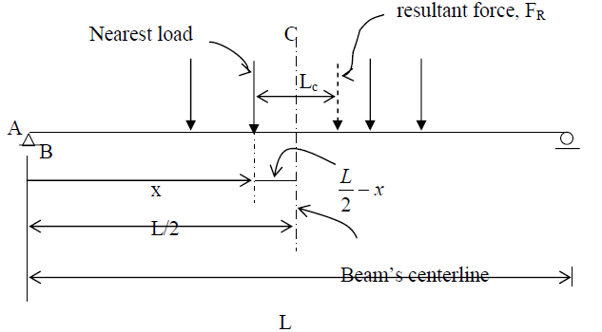

Slide 51
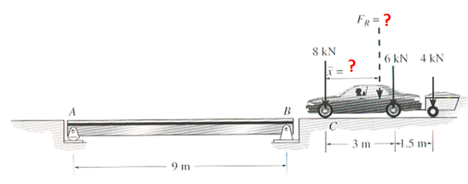
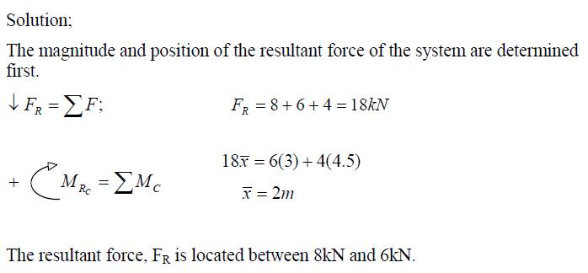
EXAMPLE :
Determine the absolute maximum moment in the simply supported beam

Slide 52
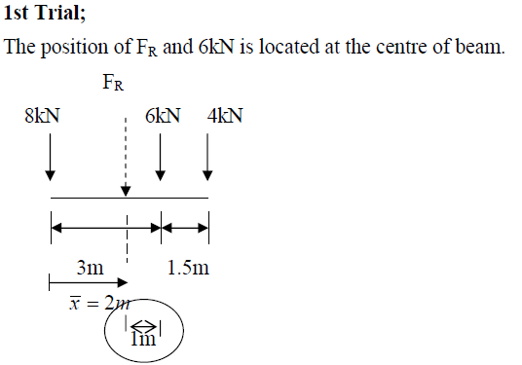
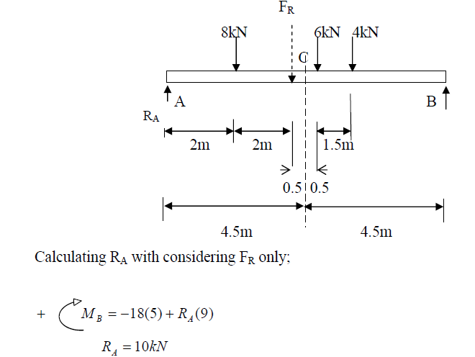

Slide 53
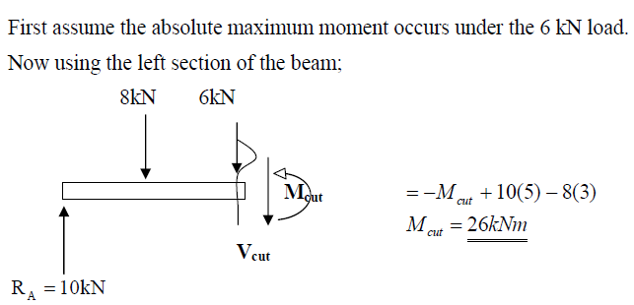

Slide 54
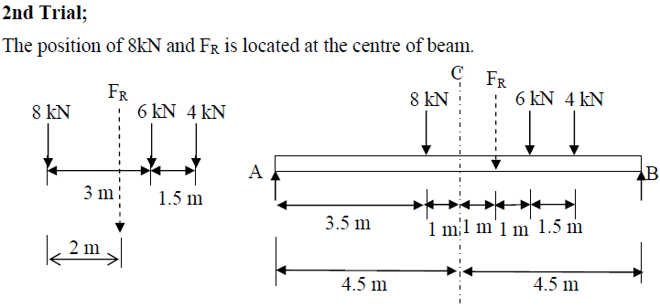

Slide 55
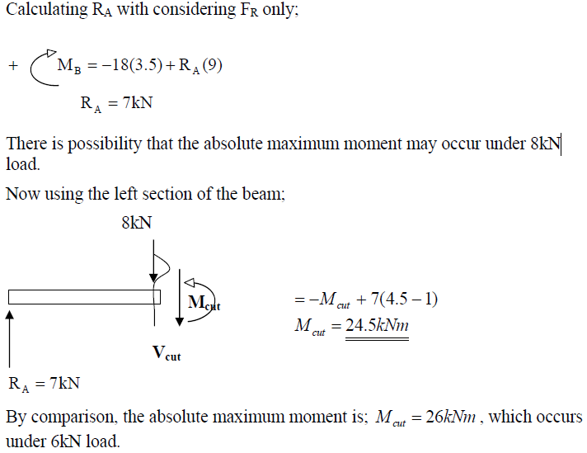

Slide 56
Thank You

