Slide 1
BRIDGE INSPECTION AND MAINTENANCE
Dr Mohd Haziman B Wan Ibrahim

Slide 2
Why We Inspect Bridges Bridge Inspection
*** TO ENSURE PUBLIC SAFETY
Bridges are key element in the road network. It is therefore necessary to manage the bridges properly and systematically to ensure that bridges are always in good condition and bridge inspection plays an important part in bridge management system.

Slide 3
Bridge Inspection
The main objective of bridge inspection:
is to ensure that the bridge continues to perform its function under acceptable conditions of safety and with a minimum maintenance.
Bridge inspector/designer must understand and able to identify the various type of defects, both on the materials and the bridge components.
Several types of inspection that carried out by PWD BRIDGE UNIT
Inventory inspection
Annual condition inspection
Confirmatory inspection
Detailed inspection

Slide 4
Bridge Inspection
Inventory inspection
The first inspection carried out on a particular bridge to collect data.
Inspection is done visually and systematically
Measurements, sketches and photographs are taken and recorded onto the inventory card.
Annual condition inspection
Mandatory yearly inspection- by JKR district- to ensure that bridges are safe, functional and well maintained.
Done once a year, preferably during the period after the flood season.

Slide 5
Bridge Inspection
Confirmatory inspection
This inspection follows the annual condition inspection, to ensure reporting done by the tea, (district) are consistent with the established rating criteria on those bridges which are reported to be defective. This is carried out by inspection team from the bridge unit.
The inspection enable the bridge unit to prepare the programme for detailed inspection.
Detailed inspection
Will be carried out by engineers from bridge unit after confirmatory inspection identified the need for bridge to be rehabilitated.
Defects inspection , testing samples of defective materials and partly to assess the cause and extent of damage. Recommendations will then be made on the most feasible rehabilitation methods.

Slide 6
Common problems for Malaysia Bridges
They are:
i. Problems in concrete members
ii. Problems in steel members
iii. Bearing problems
iv. Joint problems
v. Hydraulic problems
vi. Excessive vibrations
vii. Impact of vehicles
viii. Vegetation growth

Slide 7
PROBLEMS IN STEEL MEMBERS - Corrosion
Corrosion is the deterioration of steel by chemical or electro-chemical reaction resulting from expose to air, moisture, air-borne salts, industrial fumes and other chemicals and contaminants in the environment.
If the damage process continues, it will resulted in progressive loss of section.

Slide 8
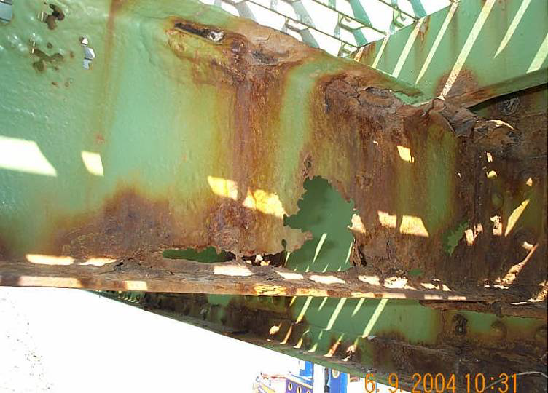
Fig. 6 : Total loss of section of a steel girder bridge

Slide 9
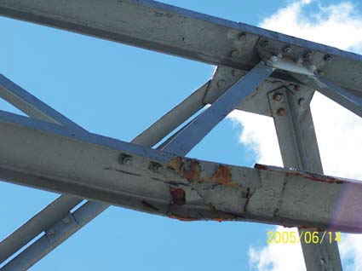
PROBLEMS IN STEEL MEMBERS - Corrosion
In the case of steel truss bridges (Fig. 3) some corrosion at the connection and damage from vehicular impact.
Fig. 3 : Deformation of member of a steel truss bridge in Sarawak due to vehicular impact

Slide 10
PROBLEMS IN STEEL MEMBERS - Corrosion
In the case of corrugated multi-plate culverts CMPs, the main problem is corrosion.
The loss in capacity due to the corrosion might have been the cause of the structural failure (Fig. 5).
No matter, the CMPs are progressively being replaced with concrete culverts.
Fig. 5: Widespread corrosion at bottom half and joints of a CMP

Slide 11
PROBLEMS IN STEEL MEMBERS - cracking
It is a linear fracture mainly due to fatique and can, under certain conditions, lead to brittle fracture.
Brittle fracture is a crack completely through the component that usually occurs without warning or plastic deformation. If the damage process continues, it will resulted in progressive loss of section.

Slide 12
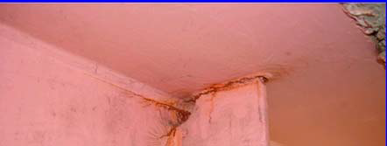
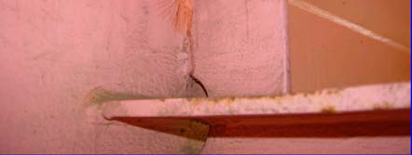

Slide 13
PROBLEMS IN STEEL MEMBERS - Permanent deformations
Permanent deformation of steel members can take the form of bending, buckling, twisting or elongation, or any combination of these.
This deformation may be caused by overloading, vehicular collision, or inadequate or damage intermediate lateral supports or bracing.
This type of damage may be critical to the integrity of the member.

Slide 14
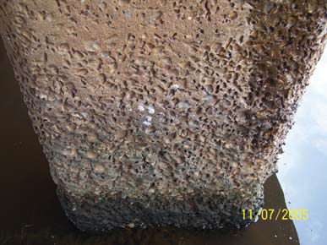
PROBLEMS IN CONCRETE MEMBERS- direct chemical
Concrete may be susceptible to direct chemical or acid attack as seen in Fig. 7 , but by and large, cracking and spalling of concrete are most common in Malaysia.
Fig. 7: Acid attack of lime stone aggregates

Slide 15
PROBLEMS IN CONCRETE MEMBERS - cracking
It is a linear fracture in concrete which extends partly or completely through the member.
It is occurs as a results of tensile stresses.
A great many cracks are caused in the early days after construction by the tensile stresses that result from various restraints to shrinkage.
The important distinction affecting repair is whether a crack is dormant or active.
Severity
Hairline crack
Narrow crack
Medium cracks
Wide cracks

Slide 16
PROBLEMS IN CONCRETE MEMBERS - cracking
Some of the most common types of cracks are:
Plastic Shrinkage Cracks
Drying Shrinkage Cracks
Settlement/Subsidence Cracks
Temperature Induced Cracks
Flexural Cracks
Shear cracks

Slide 17
PROBLEMS IN CONCRETE MEMBERS - cracking
Plastic shrinkage cracks form in the deck when the evaporation rate exceeds the bleed rate of newly placed plastic concrete.
Extreme environmental conditions and high concrete temperatures increase the surface evaporation rate and thus increase the deck vulnerability to plastic shrinkage cracks.

Slide 18
PROBLEMS IN CONCRETE MEMBERS - Flexural Cracks
Can form when the concrete is in it’s initial maturing stage just after placement as well as in service.
If unshored, concrete in its plastic stage can develop flexural cracks in the negative moment regions over the interior supports of continuous spans due to the dead weight of the girders plus the newly placed concrete.
When the deck is in service, the addition of live loads can also cause cracking in the negative moment regions.

Slide 19
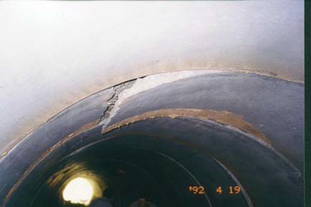
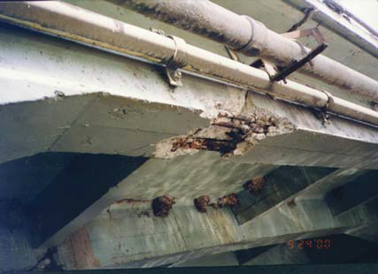
LOAD INDUCED CRACK
Flexural problem in RC culvert (note tension crack at the crown)
Flexural and shear problem in beams

Slide 20
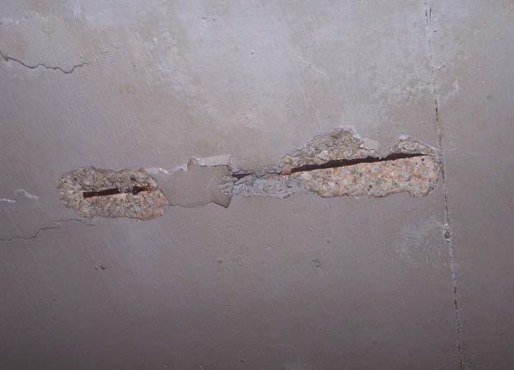
PROBLEMS IN CONCRETE MEMBERS - cracking
CORROSION INDUCED
The steel reinforcement corrodes and expands causing the
concrete to crack, delaminate and spall (Fig. 8). This is known as carbonation
Fig. 8: Cracks and spalling of concrete due to carbonation

Slide 21
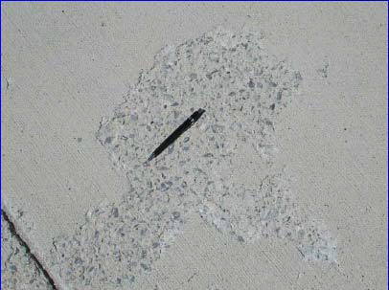
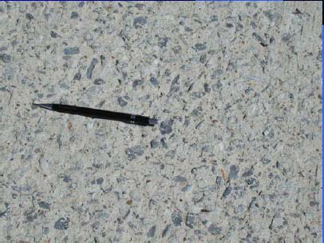
PROBLEMS IN CONCRETE MEMBERS - scalling
Local flaking or peeling away of the near surface portion of hardened concrete

Slide 22
PROBLEMS IN CONCRETE MEMBERS - cracking
CORROSION INDUCED
The steel reinforcement corrodes and expands causing the
concrete to crack, delaminate and spall (Fig. 8). This is known as carbonation

Slide 23
PROBLEMS IN CONCRETE MEMBERS - Spalling
Occurs when a segment of the concrete surface, frequently a rough circular or oval shape, is missing.
Two common causes of spalling are:
Corrosion of the reinforcement
Improperly constructed or maintained joints
Spalling may also be caused by overloading of the concrete in compression. This result in the breaking off the concrete cover to the depth of the outer layer of reinforcement.
It can be occur in areas of localized high compressive load concentrations, such as at structure supports.

Slide 24
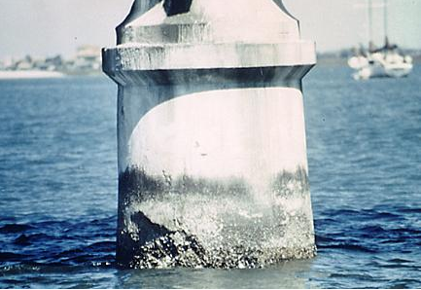
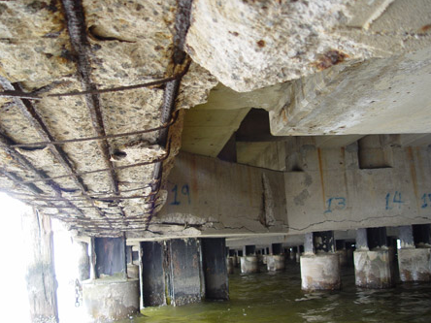
PROBLEMS IN CONCRETE MEMBERS - Spalling
Spalling of concrete piling
Concrete spalling reveals severe rebar corrosion

Slide 25
BRIDGE BEARING PROBLEMS
Problem of walking bearings is rather common in Malaysian bridges (Fig. 13). Each case may be unique but all happened in the situation when the bearing is not uniformly loaded.
Many methods had been used to overcome the problem but they largely involve provision of restraint to the existing bearings.

Slide 26
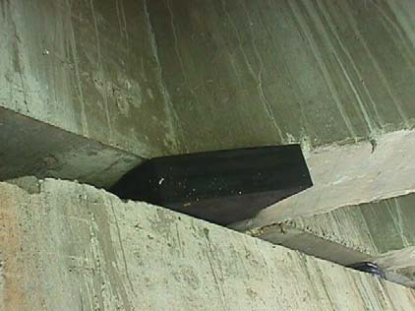
Fig. 13: Walking of the diamond shape bearing

Slide 27
The problem of walking bearing mainly involves elastomeric (rubber) bearings.
There were, however, some bearing problems related to mechanical bearings.
In Jambatan Ahmad Shah Termeloh, the roller pins of two of the HiLoad type (a trade name) bearings were displaced
Fig. 14: Roller pin of the mechanical bearing for Ahmad Shah Bridge

Slide 28
HYDRAULIC PROBLEMS
Scour is the removal of material from the stream bed or bank due to the erosive action of moving water in the stream. It can be general or local.
General scour occur due to constriction to the general flow created by the structure.
Local scour occurs as a result of an obstruction to the flow such as, a pier, an abutment or accumulation of debris such as timber log in the stream,

Slide 29
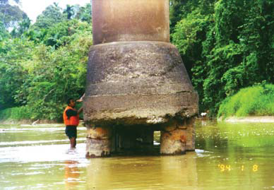
HYDRAULIC PROBLEMS
Scouring of river bed, either general scour or local scour around the piers causes instability of the bridge (Fig. 16)
Fig. 16: General scouring of river bed at Sg. Jeniang

Slide 30
Scour
SCOUR is loss of ground support

Slide 31
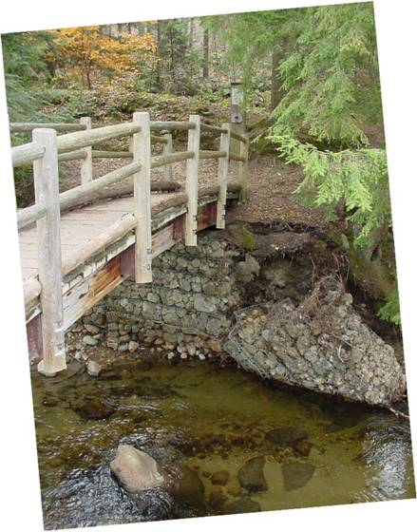
Scour
“Undermining”
is localized scour under a Substructure

Slide 32
Scour
Scour failure is most common in bridges that are too short

Slide 33
Scour
Scour failure is also common in areas where the banks are weak and unprotected by vegetation or riprap

Slide 34
Scour
Is this substructure fully supported?

Slide 35
HYDRAULIC PROBLEMS
Bridge that stretch of water need to be designed to satisfy not only the structural, but also the hydraulic requirement.
The hydraulic design includes consideration of both the capacity of the flood peak through the bridge opening as well as the ability of the bridge foundation to withstand the loading imposed on the bridge.
The integrity of the bridges is often jeopardized when scouring occurs at its foundation.
In Malaysia, bridge failure due to structural damage is very rare.

Slide 36
The main cause of bridge failure is over-topping of the bridge deck or washout of embankment during major floods.
Hydraulic considerations are extremely important (bridges and culverts). Practicing engineers should consider the correlations between bridges failure and hydraulic requirement in their design particularly proper considerations of the fluid-sediment structure interaction. This is the main cause of foundation failure around the structure.

Slide 37
The design philosophy practiced in Public Works Department build upon the considerations that bridges may fail due to:
Inadequate flow capacity leading to over-topping of the bridge deck or, the approach embankments,
Increased loading on the structure from water, sediment or debris; and
Failure of the foundation or supports as a result of bridge scouring.

Slide 38
Inadequate flow capacity leading to over-topping of the bridge deck or, the approach embankments,
Solution for this problem involves the determination of the design discharge and the flow capacity. The design discharge can be calculated using either the measured stream flow data or rainfall records. Malaysia utilizes a 100-year storm for bridge design and a 50-year storm for culvert design.

Slide 39
Increased loading on the structure from water, sediment or debris;
PWD proposes the provision of a freeboard, which is the vertical distance between the highest water level and the soffit level of the bridge deck.
0.3 m to 1,0 m is used with the lower value for channels that are not expected to have debris or floating logs.
If debris or floating logs are expected, the force exerted by these objects on the piers must also be considered in the design of the structure.

Slide 40
PWD and its collaborator have indentified many ‘hydraulic defects’ in Malaysian bridges as summarized below;
Inadequate bridge opening
Inadequate slope protection around abutment
Unsuitable ridge sitting at sharp bends
Piers skewed to river flow;
Obstacles like old bridge piers remain under bridge
Floating logs or debris not removed; and
Rivers and mining activities near the bridge sites.

Slide 41
PWD has adopted the following recommendations
The bridge structure should cross the river perpendicularly
Abutments should not protrude into the waterway
The number of piers in the river should e minimized
The shape of bridge piers should, as far as possible, be oval; and
The pile caps should be buried at least 1.2m below the expected scoured depth.

Slide 42
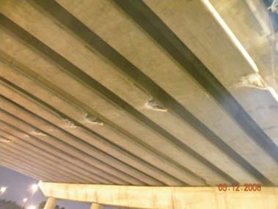
Impact of vehicles
Damage of bridge components by impact of vehicles is common for urban bridges. Fig. 1 and Fig. 2 show some recent examples.
Fig. 1: Damage at underside of a beam in K.L. due to vehicular impact
Fig. 2: Damage at underside of beams of a bridge in Shah Alam due to vehicular impact

Slide 43
Vegetation growth
Vegetations growing in bearing shelves of abutments and piers is also very common in Malaysian bridges.
Their presence does not actually cause any physical damage to the bridge component. However, the roots tend to collect dirt and retain water which can cause long term durability problem.
Fig. 15: Vegetation growth at bridge abutment

Slide 44
Joint problems
Loose Connections
Occur in bolted or riveted connections; and caused by corrosion of the connector plates or fasteners, excessive vibration, over stressing, cracking, or the failure of individual fasteners.
It may sometimes not be detectable by visual inspection.
The damage such as cracking, excessive corrosion of the connector plates or fasteners, or permanent deformation of the connection or members framing into it, may be indications of a loose connection.
Tapping the connection with hammer is one method of determining of the connection is loose.

Slide 45
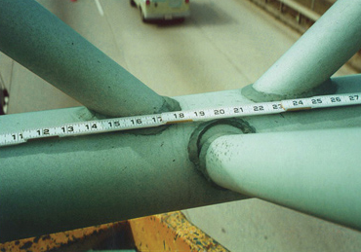
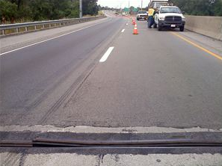
Joint problems
Failure of welded joint
popped up of piece of an expansion joint.

Slide 46
Types of damage Bridge Inspection
Water leak
The sign is indicated by dampers, fungus or mould growth and sometimes vegetation growth.
It is also as a result of defective expansion joint, construction joint, porous concrete, micro-crack within concrete itself and inadequate drainage.
Periodic wetting and drying at the leak area will eventually lead to material deterioration.

Slide 47
Types of damage Bridge Inspection
Tilt/settlement
Tilt normally occurs due to uneven settlement of foundation, displacement of pier (inclination) due to traffic impact or slip circle failure.
The type of damage can be considered as serious and should be reported immediately.

Slide 48
Bridge Maintenance
Bridge maintenance avoids larger scale work .
Bridge maintenance encompasses:
Cleaning activities, including annual water flush of all decks, drains, bearings, joints, pier caps, abutment seats, concrete rails, and parapets.
activities such as painting, coating and sealant applications and for routine, minor deck patching and railing repairs.
Technical and specialized repairs, including jacking up the structures, crack repairs, epoxy injection, repairing or adjusting bearing systems, repair and sealing of expansion joints, repair or reinforcement of main structural members to include stringers, beams, piers, pier and pile cap, abutments and footings, underwater repairs, major deck repairs, and major applications of coatings and sealants.
Stream channel maintenance including debris removal, stabilizing banks and correcting erosion problems

Slide 49
Bridge Maintenance Bridge maintenance
In Malaysia, the Department of Work (JKR) issues an illustrated guide to classify the type and severity of the various defects in construction bridges.
It is important to get fuller information about the rates of deterioration. If deterioration is neglected it will get worse.
** It is invariably more economical to repair sooner rather than later and before the need of replacement.

Slide 50
Bridge Maintenance Bridge maintenance
The initial cost and maintenance cost over the life of the bridge govern when comparing the economics of different bridge types.
A general rule is that the bridge with the minimum number of spans, fewest deck joints, and widest spacing of girders will be the most economical.
For Example:
(1) By reducing the number of spans in a bridge layout by one span, the construction cost of one pier is eliminated.
(2) Deck joints are a high maintenance cost item, so minimizing their number will reduce the life cycle cost of the bridge.
(3) When using the empirical design of bridge decks in the AASHTO (1994) LRFD Specifications, the same reinforcement is used for deck spans up to 4.1m. Therefore, there is little cost increase in the deck for wider spacing for girders and fewer girders means less cost although at the “expense” of deeper sections.

Slide 51
Bridge Maintenance Bridge maintenance
Generally, concrete structures require less maintenance than steel structure. The cost and hazard of maintenance painting of steel structures should be considered in type selection studies.
One effective way to reduce the overall project cost is to allow contractors to propose an alternative design or designs.

Slide 52
Measures to improved durability
Better concrete covers to reinforcement
Bridge deck water proofing
Durability improvement by using high-strength concrete or high-performance concrete (HSC/HPC) as well as new durability designs for concrete bridges in harsh environments - concrete bridges suffering corrosion in coastal areas

Slide 53
BRIDGE Repair Bridge maintenance
Repairs Using Treated Wood Products:
If treated wood is to be used, ensure it has been treated with a wood preservative appropriate for the project. Certain wood treatments (e.g., creosote) must not be used in or near freshwater.
If treated timber must be cut to size, ensure cutting takes place away from the bridge and watercourse.
Treated sawdust is harmful to aquatic organisms and must be prevented from entering any watercourse.
Wood preservatives should not be applied over water

Slide 54
BRIDGE Repair Bridge maintenance
Repairs Using Cement-based Products:
If cement-based products are used for repairs of structures in or near water (i.e., bridge abutments) strict protocols must be followed to prevent the introduction of raw product or wash water to a watercourse.
The concrete works should be isolated from water with a waterproof barrier (e.g., polyethylene sheets and wood forms or sealed sandbag coffer dams) to prevent leachate generation and contain leachate and raw materials for the duration of the product curing period (a minimum of 72 hrs).
If your repair works are small and in areas away from the wetted portion of the watercourse, isolation of the site is as simple as ensuring that any wash water generated from the repaired area is prevented from entering bridge drains and watercourses.

Slide 55
Repair technique Bridge maintenance
Deterioration of unwaterproofed bridge decks was more obvious than the waterproofed bridge decks.
Repair technique grew from traditional building practice using Portland cement mortar.
Epoxy resins – offer good strength, adhesion and impermeability
Polyester resins

Slide 56
TREATMENT OF CRACKING Bridge maintenance
Before deciding whether or how to repair cracking, its cause must first be determined. If monitoring shows that a crack is widening or lengthening, the structural cause of this has to be found and remedied.
Example of cracking treatments;
Injection to stabilized cracks.
The crack should be as clean as possible before filling. The pressure injection usually done.
Epoxies were widely used in USA to inject cracks. From research, the injecting crack with epoxy restored most of the structural integrity.

Slide 57
TREATMENT OF CRACKING Bridge maintenance
Epoxy injection uses epoxy resin to penetrate concrete cracks for the structural restoration of the concrete. Use of the epoxy injection method for repair is sometimes an alternative to building a new bridge – a considerable cost savings – and it usually restores the original structural integrity of the bridge.

Slide 58
Patch repairs Repair technique
Using
Polyester resin mortar
Epoxy resin mortar with bonding agent
Epoxy resin mortar without bonding agent
Ordinary portland cement mortar

Slide 59
Sprayed concrete Repair technique
Using
Polyester resin mortar
Epoxy resin mortar with bonding agent
Epoxy resin mortar without bonding agent
Ordinary portland cement mortar

Slide 60
Repair technique
Nature of Problem
Cracks were formed in structural members and spalling and defective concrete were found on the concrete structures due to severe corrosion of the steel reinforcement.
The Solution
Formwork grouting and patching were the major scope of works to repair the defective concrete. Strengthening to some of the beams was required to reinstate the original capacity of the beams. Protective coating was applied on the exposed concrete surface.

