Slide 1
BRIDGE DESIGN
Chapter 5:
Substructure
Dr Shahiron Shahidan
shahiron@uthm.edu.my
drshahironshahidan.weebly.com

Slide 2
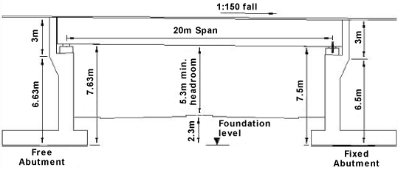
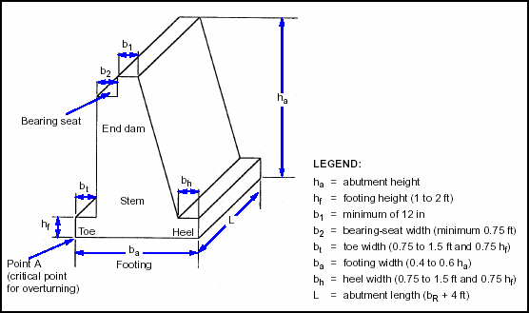
5.1 Introduction
Abutments function as both earth retaining structures and as vertical load carrying components.
Parapet abutments are detailed to accommodate thermal movements with strip seal or modular expansion devices between the concrete deck and the abutment end block.
Integral and semi-integral abutments are designed to accommodate movements at the roadway end of the approach panel.

Slide 3
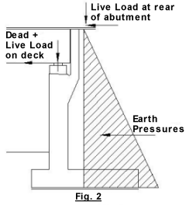
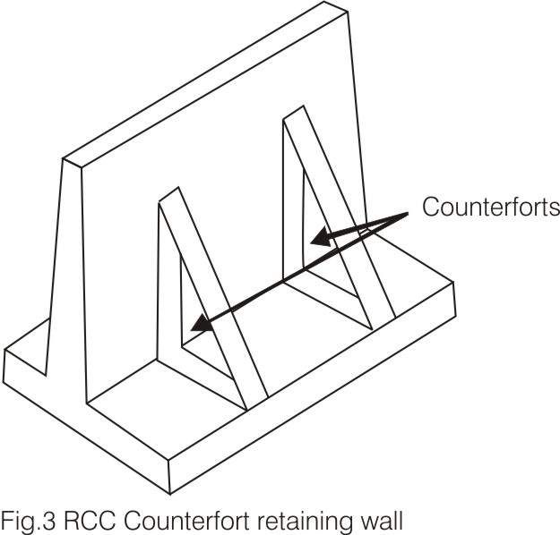
5.2 Type of Abutments
GRAVITY ABUTMENT
A gravity abutment resists horizontal earth pressure from the rear, with its own dead weight.
To be stable, this leads to massive-sized abutments.
These abutments may be of mass concrete or stone masonry.
A gravity abutment is composed of a back wall and splayed wing walls, which rest on foundation
COUNTERFORT ABUTMENT
A counterfort abutment is very much similar to a counterfort retaining wall. In counterfort abutments, a thin wall called counterfort connects the breast wall to the footing. These counterforts are spaced at regular intervals so that the breast wall is designed as a supported slab rather than as a cantilever.

Slide 4
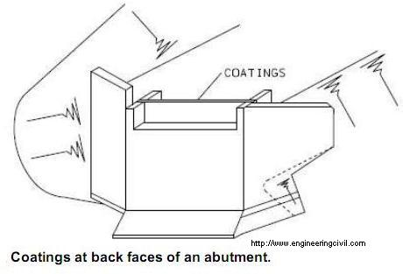
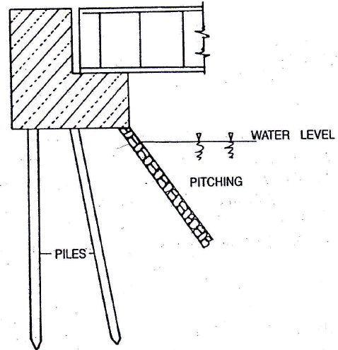
U-ABUTMENT
When the wing walls of a gravity abutment are placed at right angles to the back wall, the abutment is known as the U-abutment. The name 'U-abutment' is due to the shape of this abutment in plan. The wing walls are typically cast monolithically with the abutment back wall and cantilevered both vertically and horizontally
STUB ABUTMENTS
Stub abutments are relatively short abutments, which are placed on top of the embankment or slope. Sufficient rocky terrain must prevail at the site, so that the stub abutment can be supported on piles which extend through the embankment

Slide 5
5.3 Stabilization Analysis
The Dimension of the abutment such as top width, bottom width and front and back batters are fixed first.
These dimensions depend on type of the abutment, height requirement, depth of foundation, etc:
Table 12.1 shows the minimum top widths to be fixed for abutments based on their heights.
The bottom width should be such as to create sufficient self-weight to enable stability.
In any case, the bottom width should not be less than 0.4 times the height. The abutment so designed must be checked for stability.
An abutment must be safe against:
Overturning
Sliding
Eccentricity of the resultant with respect to centre of the base
Maximum base pressure

Slide 6
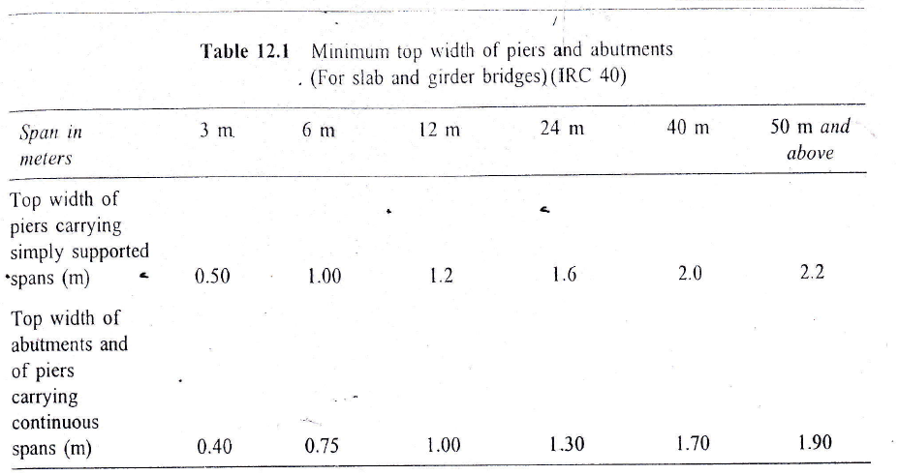

Slide 7
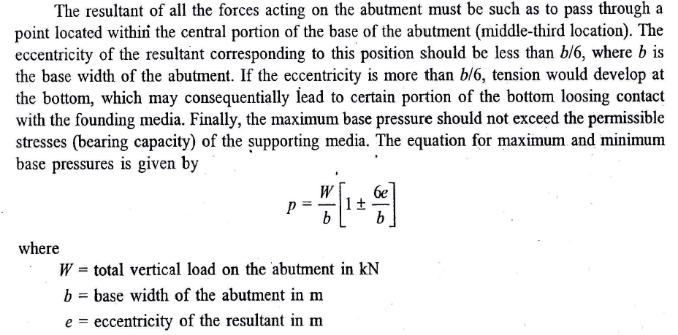

Slide 8
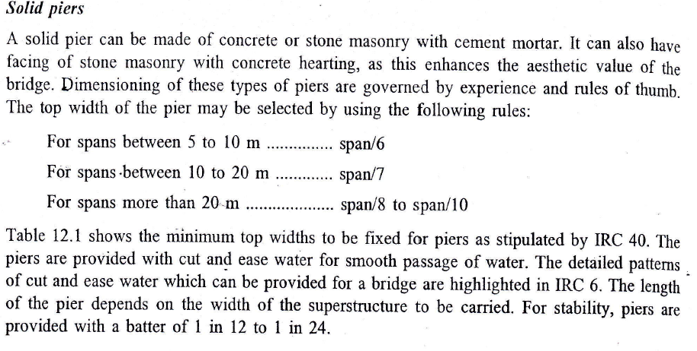
5.4 Pier
A pier is an intermediate supporting structure of a bridge. Piers are generally constructed using concrete through steel is also used. Piers are conventionally reinforced and help in:
Sustaining dead load and live load
Facilitating a long bridge to be converted into segments or bays
Adding something to the appearance of the bridge as a whole

Slide 9
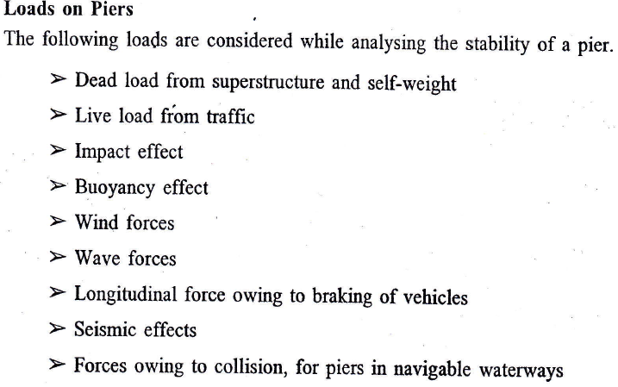

Slide 10
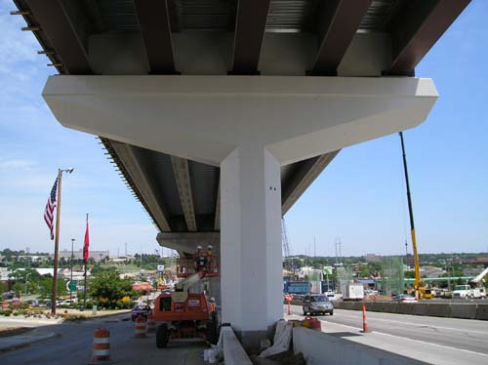
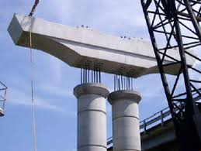
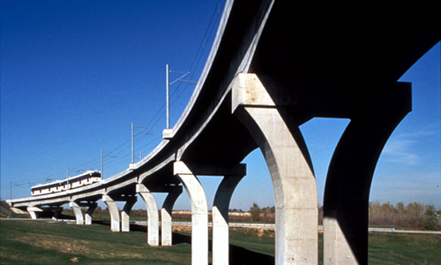
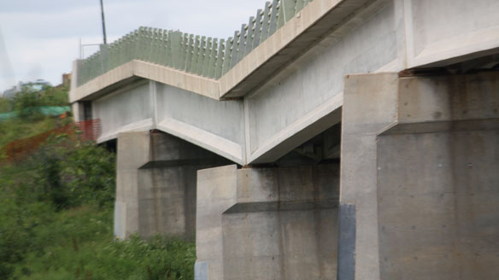

Slide 11
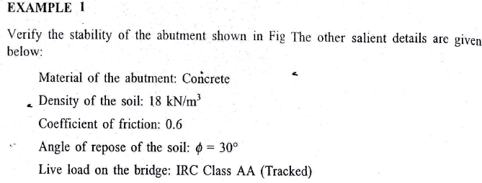
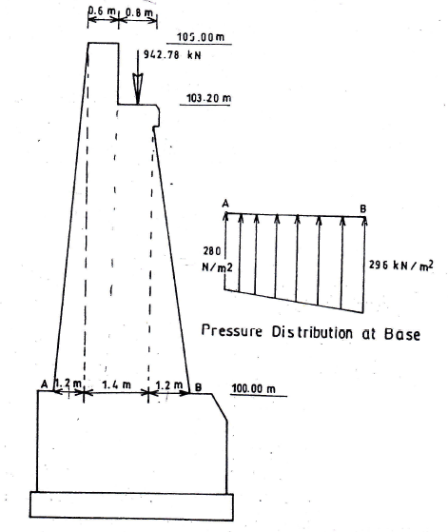
Example 1

Slide 12
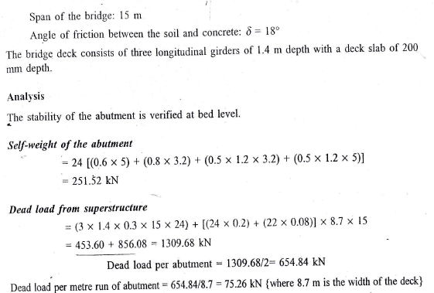

Slide 13
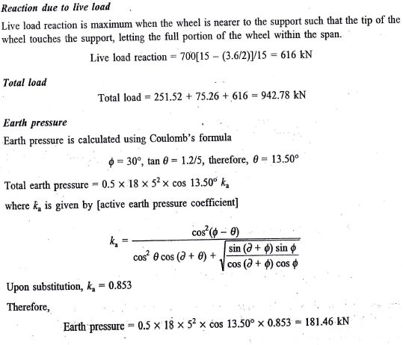

Slide 14
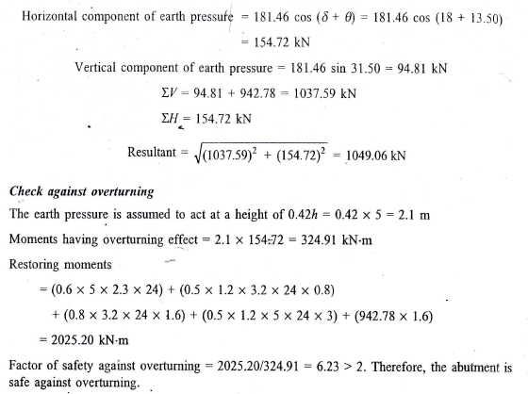

Slide 15
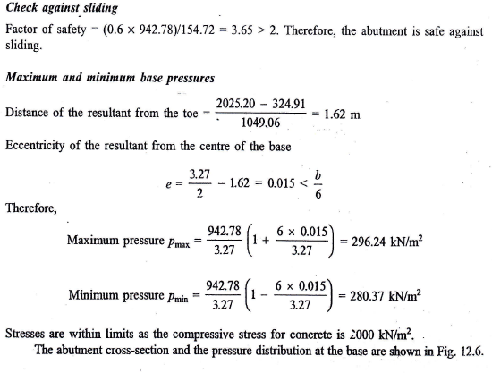

Slide 16
